Slide 1
Detecting Fake vs. Real News Using SVM and Word Clouds
LIS 4761 Intro to Data and Text Mining

Slide 2
Contributors
Patrick Aabram – Project Manager
Christine Jacob – Data Engineer
Colin Holm – Additional Data Engineer/Text Mining Analyst
Omar Eltannir – Text Mining Analyst
Zachary Wright – Visualization and Reporting Lead

Slide 3
Goal
Our aim is to develop a model which can reliably differentiate fake news articles from legitimate ones. We will also investigate the qualities of these fake articles, determining what associations and sentiments dominate their content with the goal of equipping readers to better identify fake articles by these standards.

Slide 4
Why Fake News Detection Matters
The rise of misinformation online
Impacts on public opinion, politics, and society
Need for automated detection methods

Slide 5
Dataset used for Analysis
fake-and-real-news-dataset
Dataset separated in two files:
Fake.csv (23502 fake news article)
True.csv (21417 true news article)
https://www.kaggle.com/datasets/clmentbisaillon/fake-and-real-news-dataset

Slide 6
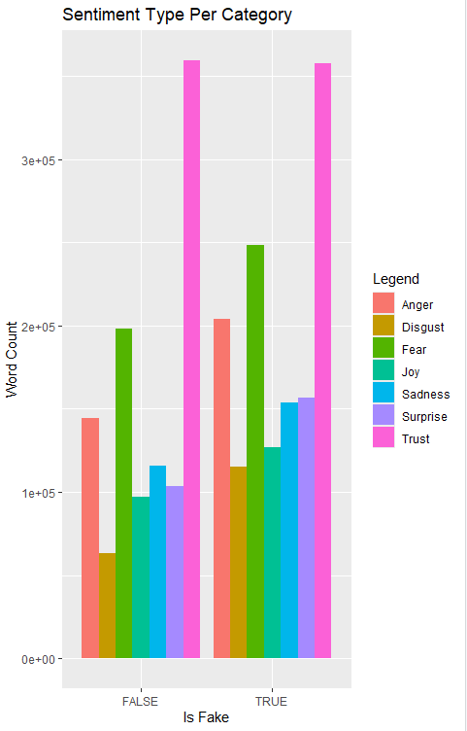
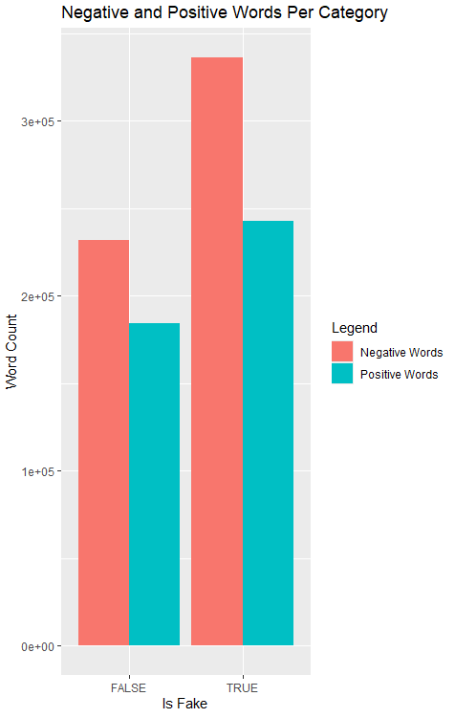
Sentiment Analysis

Slide 7
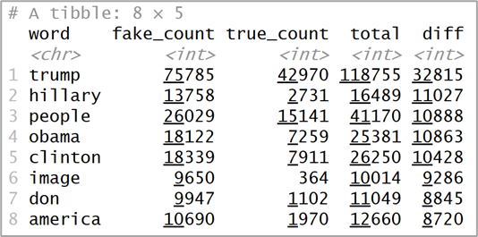
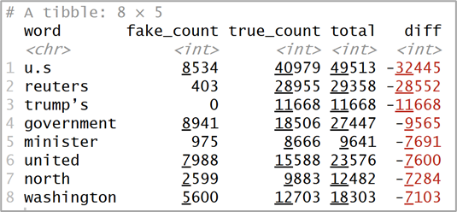
support vector machine (SVM)
Words skewed most toward fake articles (strongly positive difference)
Words skewed most toward legitimate articles (strongly negative difference)

Slide 8
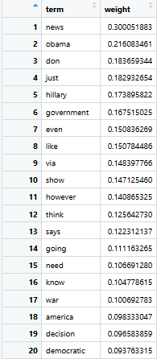
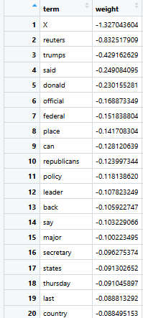
Most used words
Fake News Stories
True News Stories

Slide 9
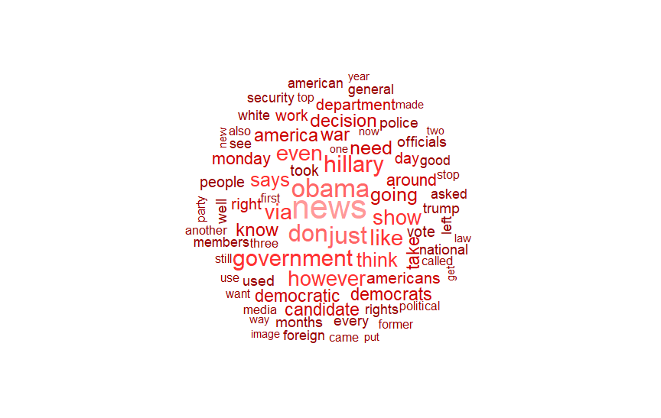
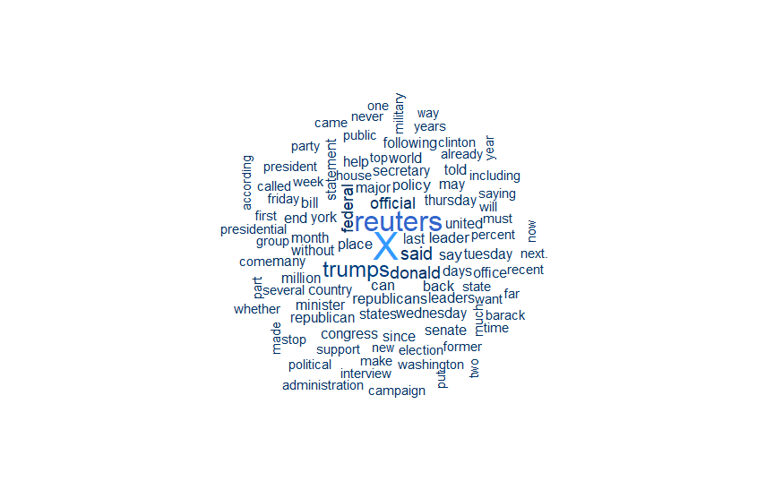
Word Clouds

